Slide 1
Notes:
Purpose of this presentation: Describe the capabilities and value of Power BI (the service, Power BI Desktop and APIs)
Target audience: Power BI Technical Decision Makers - inclusive of BI analysts and BI-focused IT professionals

Slide 2
(HIDDEN SLIDE: PLEASE DO NOT SHOW)
Title:
Power BI level 300 technical reference deck
Length and version:
60 minutes
Content level:
Level 300 for TSPs to present to the customers/partners
Deck contacts:
C+E Data platform marketing (email: sanjay.soni@microsoft.com)
Usage Guide:
This is a level 300 deck that provides technical details of the Power BI capabilities. It is intended to complement the Power BI IT Pro level 200 deck.

Slide 3
Presentation outline
01: Microsoft Power BI overview
02: Working with the Power BI service
03: Connecting to Power BI data sources
04: Creating Power BI Desktop solutions
05: Power BI for the developer
06: Summary
Notes:
Briefly introduce the course consisting of six modules.

Slide 4
01: Microsoft Power BI overview
A new generation of BI
Introducing Microsoft Power BI
Power BI overview
Signing up for Power BI
Power BI announcements
Notes:
Introduce the module title and topics.

Slide 5
A new generation of BI
Today, BI extends to everyone
3rd wave End user BI
Everyone
2nd wave Self-service BI
Analyst to end user
1st wave Technical BI
IT to end user
Notes:
Key message:
Business intelligence, or BI, has come a long way.
During the first two waves of business intelligence, IT professionals and business analysts were the keepers of BI. They made BI accessible and consumable for end users.
While this approach still applies to complex business intelligence needs, today there is a new wave.
This third wave of BI makes BI available to every kind of user.
Talking points:
Today we’re going to discuss Power BI, which is a third-wave solution. Power BI enables EVERYONE to collect, analyze, visualize and publish data.
This third wave has the potential to expand the reach of analytics to more users than ever before. Existing analytics platforms and tools can be extended, instead of being replaced, by full-featured solutions like Power BI. Power BI directly connects to existing on-premises data, such as Analysis Services tabular models that were created by business analysts in collaboration with IT. Microsoft Excel and the new Power BI Desktop work hand-in-hand with Power BI, publishing reports and models created by business analysts and getting them more easily in the hands of the business users who can gain insight and take action.

Slide 6
A new generation of BI
Turning data into business insights is challenging
Common BI challenges include…
End-to-end view
Data often resides in disparate locations, making it difficult to see a complete picture of your business
Multiple data sources
Data residing in SaaS solutions, and other external locations, is difficult to access and refresh securely
Right data for the right users at the right time
Different roles have different needs, and business users need the latest operational data
Notes:
Power BI addresses three common business intelligence challenges that an organization may face:
Getting an end-to-end view off what is happening — because data is often in disparate locations, it can be difficult for business users to see a complete picture of your business
Managing multiple data sources — Data residing in SaaS solutions and other external locations can be difficult to manage programmatically, or access and refresh securely
Making the right data available to the right users at the right time
Mobile business users need the latest operational data at their fingertips, no matter where they are or what device they’re using
Different roles have different needs and access levels, so a one-size-fits all solution doesn’t work

Slide 7

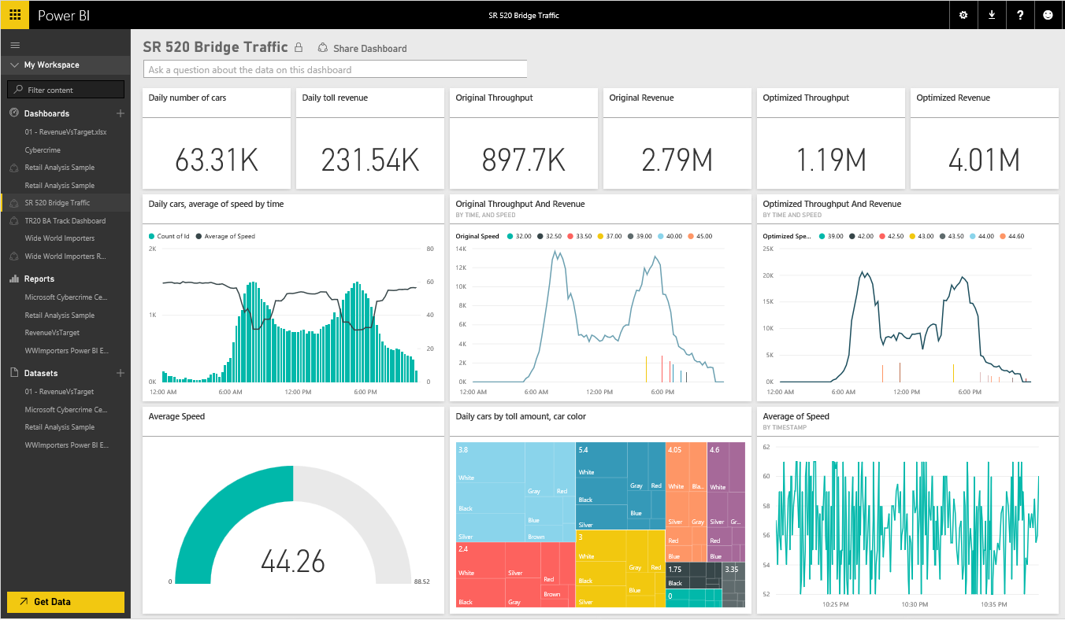
Introducing Microsoft Power BI
Experience your data. Any data, any way, anywhere.
Power BI is a cloud-based business analytics service that enables:
Fast and easy access to data
A live 360º view of the business
Data discovery and exploration
Insights from any device
Collaboration across the organization
Anyone to visualize and analyze data
Power BI
Notes:
Key message:
Power BI is a business analytics service. With Power BI you can now see all of your data through a single pane of glass. Live Power BI dashboards and reports show visualizations and KPIs from data residing both on-premises and in the cloud, providing a consolidated view across your business regardless of where your data lives.
Talking points:
This is Power BI in a nutshell and the overall benefits to your business. We will look at what this means for the IT Pro and the key benefits for IT on the next slide

Slide 8

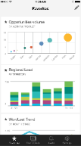
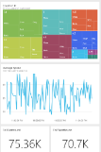
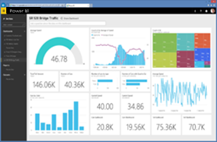
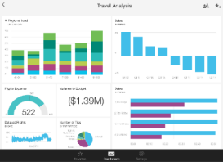
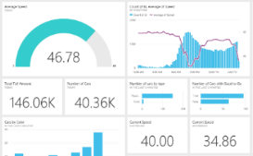

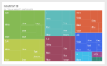
Introducing Microsoft Power BI
Key benefits and differentiators
Pre-built content packs, consisting of dashboards and reports, for popular SaaS solutions
Real-time dashboard updates
Secure, live connection to your data sources, on-premises and in the cloud
Intuitive data exploration by using natural language query
Integration with familiar Microsoft products, and commitment for scale and availability in Azure
Fast deployment, hybrid configuration, secure, and integrated with existing IT systems
Notes:
Key message:
There are several capabilities that differentiate Power BI from other offerings in the market.
Talking points:
Power BI is a cloud-based analytics service that provides faster time to insight. It is used for visualizing, exploring and extracting insights from data. It brings together data from diverse sources to deliver rich, comprehensive views of business operations.
What that means is, with Power BI, you can see all of your data through a single pane of glass, and create an analytics environment in minutes to monitor data and share reports. Live dashboards and reports show visualizations and KPIs from data that reside both on-premises and in the cloud, providing a consolidated view across your business regardless of where your data lives.
There are several capabilities that are unique to Power BI – these include:
Pre-built dashboards and reports for popular SaaS solutions such as Marketo, Salesforce, GitHub, ZenDesk, Dynamics CRM, and many others
Dashboards and visualizations that support real-time updates
Secure, live connection to on-premises data sources to drive insight across the entire range of organizational information (Analysis Services, Azure SQL Database, SQL Database Auditing, Azure SQL Data Warehouse)
Automated scheduled refresh to keep your Power BI data in sync with on premises data sources
Native mobile applications for keeping users connected on the go
Easy integration with other Microsoft offerings, from Excel to Azure services
Intuitive data exploration, which enables users to ask questions of their data in plain English
To summarize, Power BI is a SaaS offering that enables anyone to easily connect to their data, create live operational dashboards and explore data via interactive visualizations

Slide 9


Power BI overview
Data sources
Power BI service
SaaS solutions
E.g. Marketo, Salesforce, GitHub, Google analytics
Content packs
Natural language query
Sharing & collaboration
On-premises data
E.g. Analysis Services
Live dashboards
Organizational content packs Corporate data sources, or external data services
Visualizations
Azure services
E.g. Azure SQL, Stream Analytics
Reports
Excel files
Workbook data or data models
01001
10101
Power BI Desktop files
Related data from files, databases, Azure, and other sources
Datasets
Data refresh

Slide 10

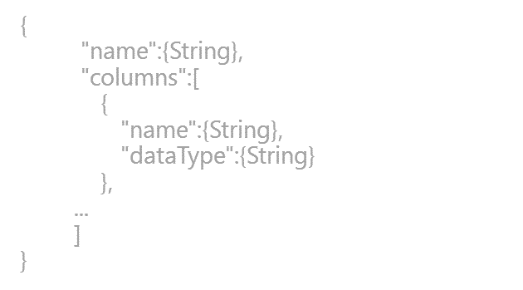
Power BI overview
SaaS solutions
E.g. Marketo, Salesforce, GitHub, Google analytics
Content packs
Natural language query
Sharing & collaboration
On-premises data
E.g. Analysis Services
Live dashboards
Organizational content packs Corporate data sources, or external data services
Visualizations
Azure services
E.g. Azure SQL, Stream Analytics
Excel files
Workbook data and data models
Reports
01001
10101
Power BI Desktop files
Related data from files, databases, Azure, and other sources
Datasets
0110001
00010110
Data refresh
Power BI Desktop
Power BI REST API
Prepare
Explore
Report
Share
Notes:
Let’s walk through an overview of how Power BI works.
1. The Power BI service, sometimes referred to as powerbi.com, is what allows you to:
Create beautiful visualizations to tell compelling data stories
Build rich, live dashboards that turn BI into business insights
Create reports & datasets from which you can create visualizations and dashboards
Enjoy the benefits of up-to-date data with real-time, automatic and scheduled refreshes
Share dashboards easily with other people in your organization
Ask questions of data in plain English with Natural Language Query
Stay connected to your data all the time with mobile applications
2. Power BI connects to a variety of data sources. These range across both cloud and on-premises sources, and include:
A variety of popular SaaS solutions, such as Marketo, Salesforce, GitHub, Dynamics CRM, Zendesk, and several others
On-premises databases – Power BI offers live connectivity to SQL Server Analysis Services, which we’ll cover in more detail later. And using a gateway solution, Power BI can connect to other database solutions.
Custom data sources – Power BI can connect to any data source you need it to thanks to its extensibility via REST APIs. This includes both proprietary corporate data sources, as well as external data services. For example, if you are a SaaS solution provider, you can work with Microsoft to connect your solution to Power BI.
Other Azure services – Power BI integrates tightly with SQL Azure and Stream Analytics, and will be integrating closely with more Azure services over time
Power BI Desktop and Excel files – Excel workbooks can be directly connected to Power BI.com, or may be used with Power BI Desktop. Power BI Desktop is a companion application to the Power BI service – it is a desktop tool that supports data analysis and reporting. Like Excel files, Power BI Desktop files may be uploaded to the Power BI service.

Slide 11
Power BI overview
No matter what industry, or what role, Power BI is relevant
Business user
Import data from SaaS sources, and work with dashboards and reports
Business analyst
Import, reshape, integrate and model data
Create compelling reports and visualizations
Create content packs to share insights
BI professional
Connect to live Azure data services
Connect to on-premises Analysis Services databases
Empower colleagues to create their own reports
Developer
Integrate applications with Power BI
Create real-time dashboards
Develop custom visuals
Notes:
This slide can be used to categorize the Power BI features into different roles.
During this course, different topics will be relevant to different roles – so it is good to define these early on.

Slide 12
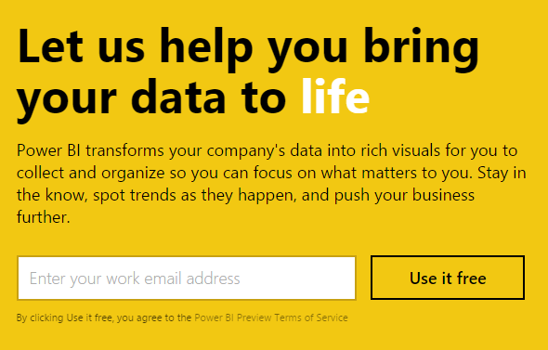
Signing up for Power BI
Sign up can be achieved for free, and within seconds
Power BI works only with an organizational account, associated with a work or school email address
Encourage customers to trial Power BI for free, and to realize the benefits of Power BI Pro features
Note: Pricing and licensing will be described in the final module
Notes:
Key message:
Get started quickly with the Power BI service (powerbi.com) for faster decision-making by displaying all of your data in one place
Talking points:
As discussed earlier, you can get started quickly with pre-built content packs for popular SaaS solutions
The primary capability of Power BI is that it empowers you to create and customize live dashboards – dashboards that include visualizations from multiple data sources
That is, dashboards can show different types of data from a variety of sources, and can use a range of unique visualizations
If applicable, you can track status in real-time thanks to support for real-time data sources
You have full control over your dashboards – pin any visualization from any report to any dashboard
Click through visualizations to access their underlying reports to discover more data and new insights

Slide 13
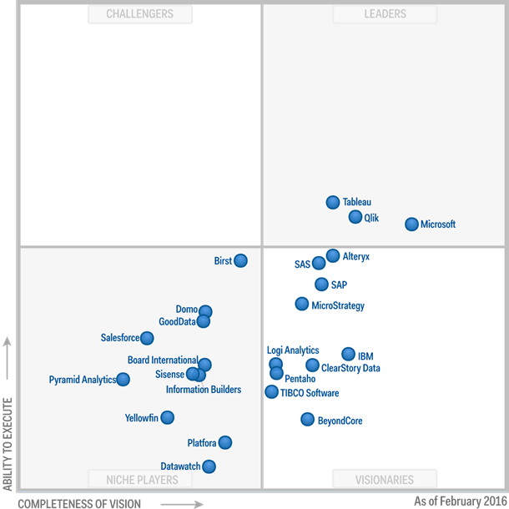
Power BI announcements
Gartner positions Microsoft as a leader in BI and Analytics Platform
February 2016:
Gartner has positioned Microsoft as a Leader, for the ninth consecutive year, in the Magic Quadrant for Business Intelligence and Analytics Platforms
For further information, read: https://powerbi.microsoft.com/en-us/blog/gartner-positions-microsoft-as-a-leader-in-bi-and-analytics-platforms/
Notes:
For further information, read: https://powerbi.microsoft.com/en-us/blog/gartner-positions-microsoft-as-a-leader-in-bi-and-analytics-platforms/

Slide 14
Key takeaways
Power BI is a cloud-based business analytics service, delivering end user BI
Power BI delivers numerous benefits and differentiators
Pre-built content packs
Real-time dashboard updates
Live connections to on-premises and cloud data sources
Intuitive data exploration by using natural language query
Integration with familiar Microsoft products and services
Fast deployment, hybrid configuration, secure, and integrated with existing IT systems
Microsoft is placed furthest in vision within the BI and Analytics Platform Leaders quadrant
Notes:
Use this slide to describe the key takeaways of the module.

Slide 15
Resources
Power BI site
http://powerbi.microsoft.com
Power BI documentation
http://support.powerbi.com/
Power BI community
http://community.powerbi.com/
Power BI blog
http://blogs.msdn.com/b/powerbi/
Tip: Power BI is evolving at a rapid rate. One of the best ways to keep pace with updates is to subscribe to the Power BI blog.
Notes:
Use this slide to provide relevant resources to allow attendees to continue with deeper content.

Slide 16
Resources
Continued
Microsoft Cloud and Enterprise Partner Resources
http://aka.ms/powerbipartners
Includes up-to-date resources:
Customer-ready materials
Customer evidence
Training and labs
Demos
“What to do next”
Gartner positions Microsoft as a leader in BI and Analytics Platforms
https://powerbi.microsoft.com/en-us/blog/gartner-positions-microsoft-as-a-leader-in-bi-and-analytics-platforms/

Slide 17
02: Working with the Power BI service
Introducing the Power BI online service
Creating and exploring reports
Assembling dashboards
Exploring with Q&A
Mobile applications
Sharing and collaborating
Describing additional capabilities
Tenant settings
Notes:
Introduce the module title and topics.
It is recommended that you become fully familiar with the module content by researching the topics at the Power BI knowledgebase: https://support.powerbi.com/knowledgebase - many links are provided in the presenter notes.

Slide 18
Introducing the Power BI online service
The Power BI online service offers a simple, intuitive experience for interacting with data
The service and features have been designed to:
Simplify engaging with data from heterogeneous sources
Fuel faster, more insightful business decisions
Deliver a rich, consolidated view of key information, no matter where the underlying data is stored
Share data insights
Notes:
Power BI Knowledgebase: https://support.powerbi.com/knowledgebase/topics/88770-services-in-power-bi

Slide 19





Introducing the Power BI online service
Continued
Users engage with the service by using a supported web browser, or mobile application
Microsoft Edge
Internet Explorer, 10 or 11
Chrome desktop, latest version
Safari Mac, latest version
Firefox desktop, latest version
Note: Mobile applications will be covered later in this module

Slide 20
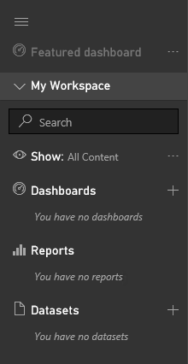
Introducing the Power BI online service
Continued
Users typically work with Power BI “building blocks”:
Datasets
Reports
Dashboards
Use the Navigation Pane to create, or select items of interest
Note: Creating and managing datasets will be covered in the next module

Slide 21
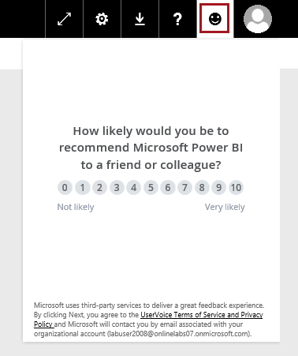
Introducing the Power BI online service
Providing feedback
Feedback can be provided to:
Convey likelihood of recommending Power BI
Explain why this score was given, and adding an optional screenshot
Allow participation in helping Microsoft decide which Power BI features should be added next

Slide 22
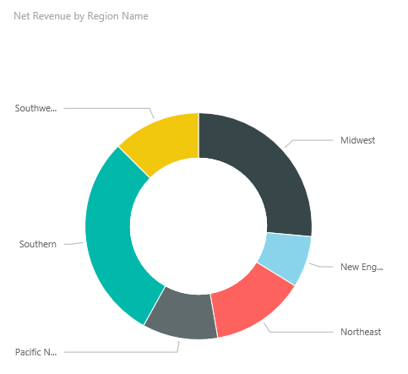
Creating and exploring reports
Creating reports
Use reports to layout visualizations across one or more pages
Rich, interactive reports can be created, updated and explored in the web browser experience
A report is based on a single dataset
Reports consist of one or more pages
Each page can be named, and consists of visualizations and shapes
Notes:
Power BI Knowledgebase: https://support.powerbi.com/knowledgebase/topics/65160-visualizations-in-reports

Slide 23
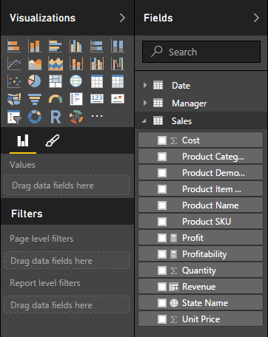
Creating and exploring reports
Creating reports
Dataset fields are used to layout a visualization
Visualization type and format can be adjusted to suit
Filtering can be applied at report, page or visualization level
Sorting can be set at visualization level

Slide 24
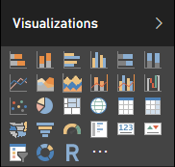
Creating and exploring reports
Creating reports: Visualization types
Choose from numerous modern visualization types:
Filter data:
Slicer
Display numeric values:
Card, Multi Row Card, Table, Matrix, KPI
Graphically visualize data:
Bar, Column, Line, Combo, Scatter, Waterfall, Pie, Donut, Funnel, Treemap, Gauge, R Script
Spatially visualize data:
Map, Filled map, Shape map (preview)
Import custom visuals
Tip: Hover the cursor of each icon to reveal a tooltip description of the visualization type
Custom visuals are covered later in this training course

Slide 25
Creating and exploring reports
Exploring reports
Reports are either in Reading View or Editing View
In both views, report pages can be opened in Full Screen Mode, or individual visualizations can be popped out/in to see them zoomed in/out
In Reading View:
Users cannot change the report definition
Users can interact by changing filters or sorting
Users can highlight values in one visualization to filter other page visualizations
Shared reports can only be opened in Reading View
In Editing View:
Users can interact, as in Reading View
Users can also update the report (add/remove/reorder pages or visualizations)

Slide 26
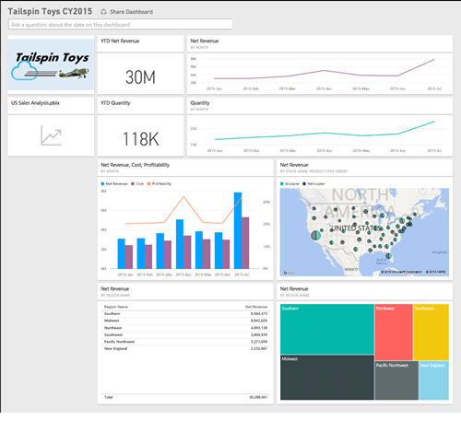
Assembling dashboards
Dashboards display tiles in a single canvas
A tile is sourced by “pinning” either a report, report visualization, or a Q&A response
A dashboard can be based on one or more datasets
Tiles can be resized and repositioned, and their titles/subtitles can be updated
Tiles can be sized to 1-5 units wide/high
Notes:
Power BI Knowledgebase: https://support.powerbi.com/knowledgebase/topics/65158-all-about-dashboards

Slide 27
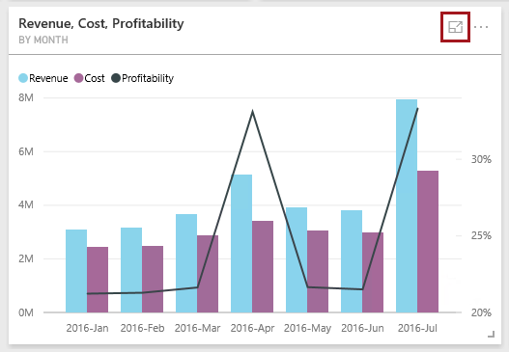

Assembling dashboards
Continued
Tiles can be opened in In-Focus Mode, filling the dashboard space
The data last updated date is displayed
Not available for tiles sourced from Q&A questions
Data can also be exported
Notes:
Power BI Knowledgebase: https://support.powerbi.com/knowledgebase/topics/65158-all-about-dashboards

Slide 28
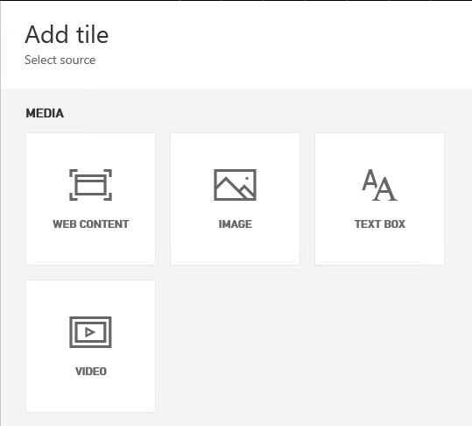
Assembling dashboards
Continued
Additionally, non data-related tiles can be added to a dashboard, using:
Web content
Images
Text boxes
Videos
Notes:
Power BI Knowledgebase: https://support.powerbi.com/knowledgebase/topics/65158-all-about-dashboards

Slide 29
Assembling dashboards
Continued
Dashboards enable interactivity
By default, clicking on a tile will drill through to its source
However, a custom link (URL) can be set to override this default behavior
Dashboard tiles can reflect live, real-time data
For non real-time datasets, tile thumbnails are automatically cached every 15 minutes
Dashboards can be displayed in Full Screen Mode
Additionally, all tiles can be displayed by using Fit to Screen
Note: Live dashboards can be achieved with Azure Stream Analytics integration or the Power BI REST API. Both topics are covered later in this course.

Slide 30
Exploring with Q&A
In the dashboard canvas, use Q&A to ask natural language questions
The dashboard must contain at least one tile to connect to a dataset, and
Only cloud-based cached datasets are supported
Q&A helps formulate an appropriate question
Q&A will format your question with suggestions, auto-complete, and even spelling corrections
Featured questions can be added to datasets
Only English questions are supported
Notes:
Power BI Knowledgebase: https://support.powerbi.com/knowledgebase/topics/70394-q-a-in-power-bi

Slide 31
Exploring with Q&A
Continued
Begin by asking “Show…”
For example:
Show <table>
Show <aggregate function><numeric column>
Show <measure> by <column>
Show <column> where <column> is before <date value>
Show <measure> where <column> is before <date value> sorted by <measure>
Show <measure> where <datetime column> is [this | last] [year | month | hour | minute | second]
Optionally, Q&A responses can be:
Customized by using the Visualizations or Fields panes
Pinned to the dashboard

Slide 32
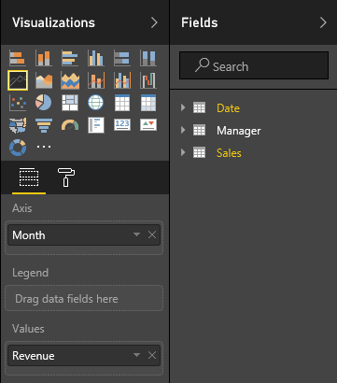
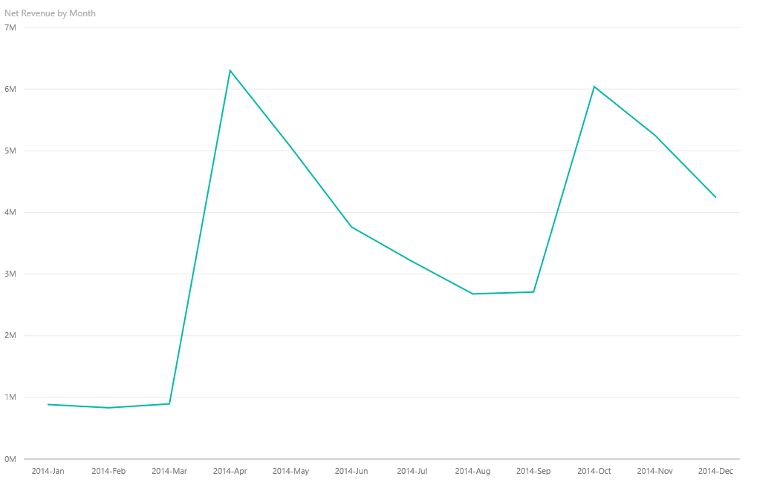
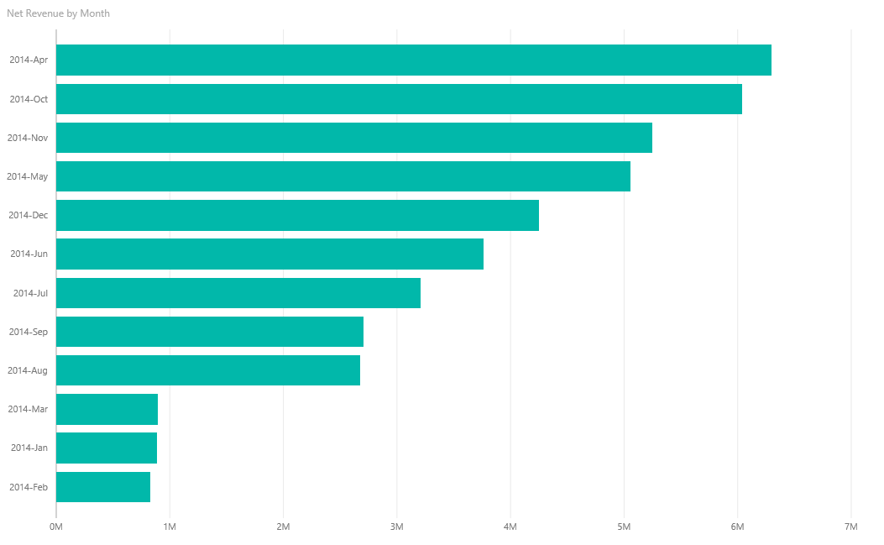
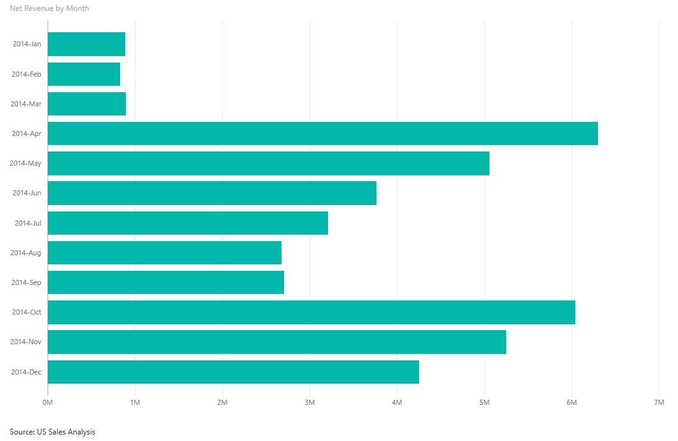

Exploring with Q&A
Example

Slide 33
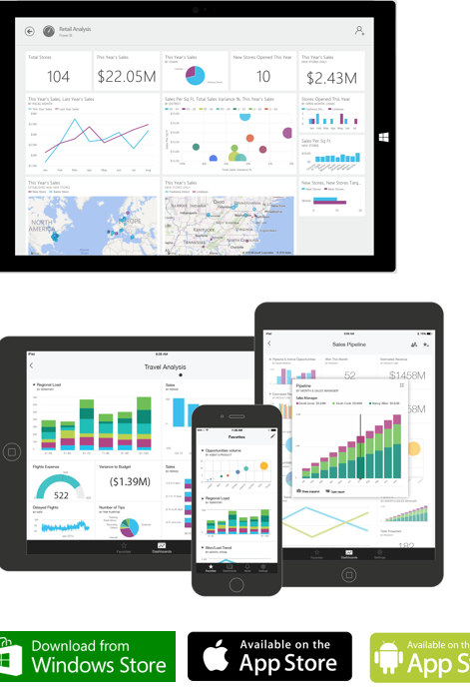
Mobile applications
Install native mobile applications to access dashboards, available for:
Windows
iOS (iPhone and iPad)
Android
Supported capabilities:
Set favorites for important visualizations
Zoom in and out of visualizations
Annotate visualizations and share snapshots with others
Configure alerts to receive notifications of critical business KPIs
Notes:
Power BI Knowledgebase:
https://support.powerbi.com/knowledgebase/topics/75729-power-bi-app-for-windows
https://support.powerbi.com/knowledgebase/topics/78002-iphone-app-power-bi-for-ios
https://support.powerbi.com/knowledgebase/topics/85887-power-bi-app-for-android-phones

Slide 34
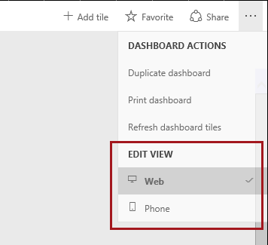
Mobile applications
Continued
Dashboards can be configured for Phone view also
Existing dashboard tiles can be resized, repositioned, or removed

Slide 35
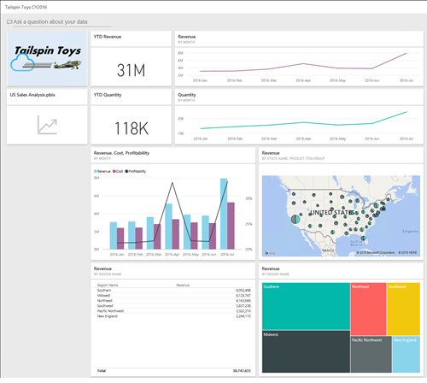
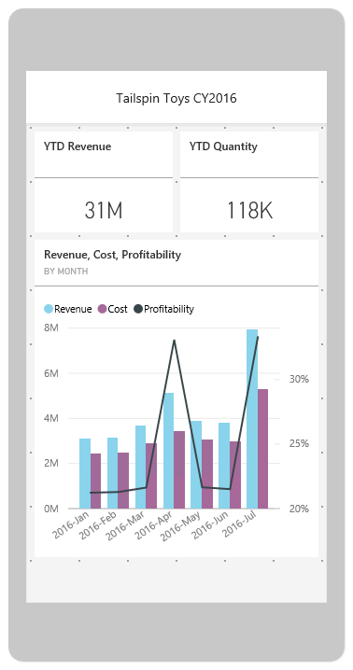
Mobile applications
Continued

Slide 36
Sharing and collaboration
Sharing and collaboration can be achieved by three different, and complimentary, techniques:
Sharing dashboards and tiles
Office 365 groups
Organizational content packs
With the exception of on-premises Analysis Services datasets, all users will see the same shared data
Requires a Power BI Pro license
Non-”Power BI Pro” users can share dashboards. However, a Power BI Pro license is required to interact with, or consume, content using features that are only available to users with a Power BI Pro license.
Notes:
Power BI knowledgebase: Power BI Pro content: https://support.powerbi.com/knowledgebase/articles/685479-power-bi-pro-content-what-is-it

Slide 37

Sharing and collaboration
Sharing dashboards and tiles
Use Sharing to provide ad hoc access to dashboards, or specific tiles
Typically suitable for users that work closely together, and that need to view dashboards or specific tiles
Shared users must have signed up for Power BI
Sharing with external users is possible—if enabled in the Admin portal
Note: Only the Windows mobile app allows sharing specific tiles
Notes:
Power BI Knowledgebase: https://support.powerbi.com/knowledgebase/articles/431008-share-and-unshare-a-dashboard-from-power-bi

Slide 38
Sharing and collaboration
Sharing dashboards and tiles: Continued
Shared items are identified by , are read-only and cannot be personalized
Dependent datasets are not made visible
The dashboard owner can:
Allow other users to re-share—internal users only
Review shared access, and stop sharing with specific users
Save dashboard changes, which then become immediately available to all shared users
Dashboards can be shared from a user’s workspace, or from a group

Slide 39
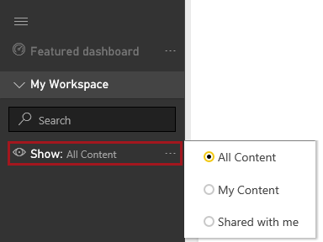
Sharing and collaboration
Sharing dashboards and tiles: Navigation pane
It is possible to filter the workspace content by showing/hiding shared assets

Slide 40
Sharing and collaboration
Office 365 groups
Use Office 365 groups to manage and share content
Typically suitable for teams/collaborators with whom you work closely for a common purpose/project
Like a user, groups can own content
The owner of the group is by default, an admin
Group admins can manage the membership, and promote others users as admins
Every member of the group:
Must belong to the same tenant
Has either read-only permission, or complete permissions to update, create and delete the group content
Must have the Power BI Pro license
Note: Groups can also share dashboards
Notes:
Power BI Knowledgebase: https://support.powerbi.com/knowledgebase/topics/101158-groups-in-power-bi

Slide 41
Sharing and collaboration
Organizational content packs
Use organizational content packs to make content available to broad audiences, and to allow personalization
Typically suitable for anyone who might be interested in this content
A content pack is defined in terms of a title, description, image, and specific items:
Datasets
Reports
Dashboards

Slide 42
Sharing and collaboration
Organizational content packs: Continued
Content packs are discoverable in the Content Gallery and can be made available to:
Entire organization—if enabled in the Admin portal
Members of a security or Office 365 group
Individuals within the same tenant
By default, dashboards and reports are read-only
However, members can unlock and personalize them
Updates made to a content pack will:
Apply automatically to non-personalized content
Notify a user that has personalized content, so they may take appropriate action

Slide 43
Sharing and collaborating
Summary and comparison of sharing techniques
 | Share | Office 365 Group | Org Content Pack
Purpose | Ad hoc | Collaboration | Broader content delivery
Target audience | Individuals, or colleagues inside or outside of the organization Typically suitable for users that work closely together, and that need to view dashboards or specific tiles | Office 365 group members Typically suitable for teams/collaborators with whom you work closely for a common purpose/project | The entire organization, or members of security or Office 365 groups, or individuals Typically suitable for anyone who might be interested in this content
Applies to | Dashboards, or specific tiles | All content | All content
Discovery | Automatic, or Invitation email | Office 365 group | Get Data ► My Organization
Permission | Read-only Datasets are not visible. Reports are in Reading View. Resharing permission can be granted. | Read-only, or Edit Members of the group will have equal rights to manage the group content | Primarily read-only Members can create a personal copy. Updated content packs that have been personalized will raise a notification.
License | Power BI, and Power BI Pro | Power BI Pro only | Power BI Pro only

Slide 44
Describing additional capabilities
Pinning SQL Server Reporting Services reports
Pinning Excel ranges
Pinning snapshots of Excel elements
Pinning real-time data (Preview)
Quick Insights
Analyze in Excel
Web publishing
Row-level security
Data alerts
Cortana for Power BI
Dashboard data classification

Slide 45
Describing additional capabilities
Pinning SQL Server Reporting Services reports
Visuals from existing, on-premises Reporting Services reports, can be pinned to Power BI dashboards
To setup, use Reporting Services Configuration Manager to register the report server with Power BI
To pin visuals, use Report Manager to select a visual and to also configure the frequency of updates (hourly or daily)
Updates are achieved by using a Reporting Services subscription
Available only with SQL Server 2016 (all editions)

Slide 46
Describing additional capabilities
Pinning Excel ranges
﻿Ranges can be pinned from Excel workbooks that have been saved in:
OneDrive for Business, or
Another group-shared document library
Ranges can contain data, charts, tables, PivotTables, PivotCharts, and other Excel parts
You can view—but not pin—tiles from workbooks that have been shared with you
Notes:
https://powerbi.microsoft.com/en-us/documentation/powerbi-service-pin-a-tile-to-a-dashboard-from-excel/

Slide 47
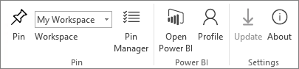
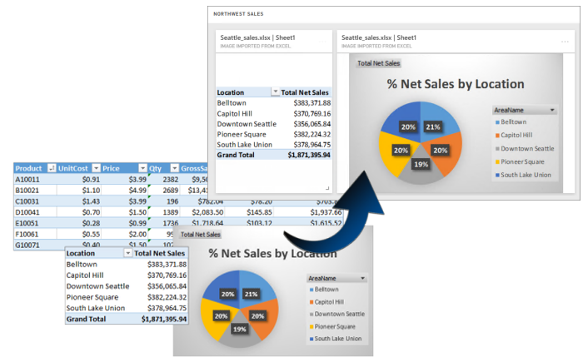
Describing additional capabilities
Pinning snapshots of Excel elements
Install the Power BI Publisher for Excel add-in to share snapshots of Excel elements to online dashboards in seconds:
Elements include PivotTables, charts, and ranges
Requires Excel 2007, or later (32- or 64-bit), and Internet Explorer 10, or later
Notes:
https://powerbi.microsoft.com/en-us/documentation/powerbi-publisher-for-excel/
https://www.microsoft.com/en-us/download/details.aspx?id=50729

Slide 48
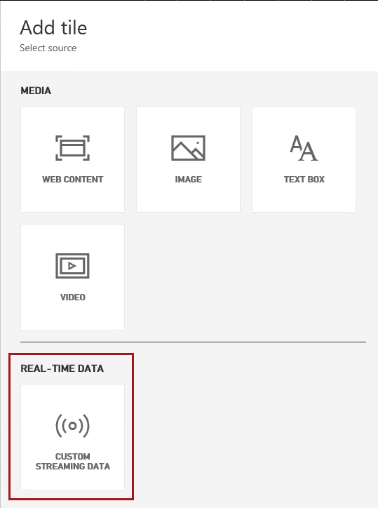
Describing additional capabilities
Pinning real-time data (Preview)
Real-time dashboard tiles can be created by pushing data to the Power BI REST APIs or from streams created in PubNub
Create real-time streaming datasets
Copy code examples to send data to the streaming dataset (raw JSON, cURL, PowerShell)
Configure real-time tiles
Notes:
https://powerbi.microsoft.com/en-us/blog/real-time-in-no-time-with-power-bi/

Slide 49
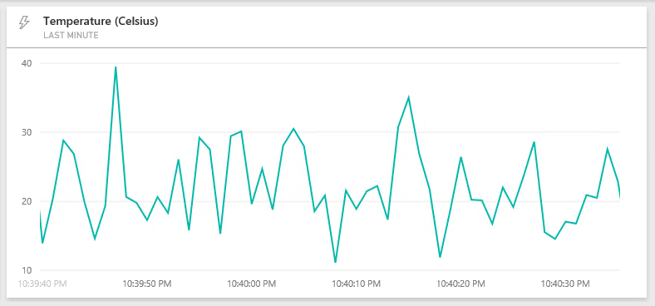
Describing additional capabilities
Pinning real-time data (Preview): Example
Notes:
https://powerbi.microsoft.com/en-us/blog/real-time-in-no-time-with-power-bi/

Slide 50
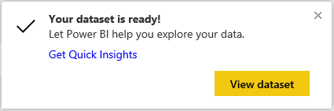
Describing additional capabilities
Quick Insights
Use Quick Insights to generate interesting interactive visualizations based on your data
Can be run on entire dataset (Quick Insights), or on a specific dashboard tile (Scoped Quick Insights)
Presents up to 32 separate insights in a special Quick Insights canvas
Insights can be pinned to dashboards, and to continue further, additional Quick Insights can be run on the insights
Notes:
https://powerbi.microsoft.com/en-us/documentation/powerbi-service-auto-insights/

Slide 51
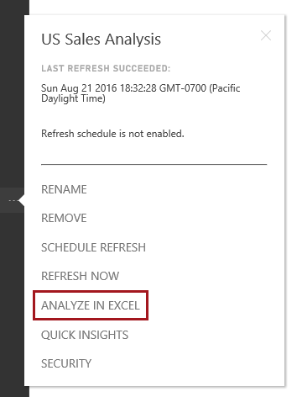
Describing additional capabilities
Analyze in Excel
With Analyze in Excel, users can view and interact with a Power BI dataset directly in Excel
They can then produce PivotTables, charts, and work with slicers based on the dataset that exists in Power BI
Supported for Excel 2010 SP1, and later
Launched from reports or datasets
Requires Excel updates be downloaded and installed
Notes:
https://powerbi.microsoft.com/en-us/documentation/powerbi-service-analyze-in-excel/

Slide 52
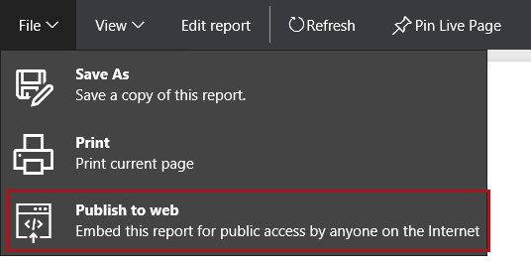
Describing additional capabilities
Web publishing
Publish to Web enables easily publishing reports into blogs and websites
When you use Publish to web, the report or visual you publish can be viewed by anyone on the Internet
There is no authentication used when viewing these reports
An embed code is generated, and can be deleted to instantly remove access
This feature can be disabled in the Admin portal
Warning: Only publish reports and data that the anyone on the Internet (unauthenticated members of the public) should be able to see. Before publishing this report, ensure you have the right to share the data and visualizations publicly. Do not publish confidential or proprietary information.
Notes:
https://powerbi.microsoft.com/en-us/publishtoweb/
https://powerbi.microsoft.com/en-us/documentation/powerbi-service-publish-to-web/

Slide 53
Describing additional capabilities
Web publishing: Continued
Data refreshes are automatically reflected in an embedded report or visual
It can take approximately one hour for refreshed data to be visible from embed codes
Limitations:
Reports using real-time data sources
Reports using row-level security
Reports using Analysis Services hosted on-premises
Reports shared to you directly, or through an organizational content pack
Reports in a group in which you are not an edit member
"R" Visuals are not currently supported in Publish to web reports

Slide 54
Describing additional capabilities
Row-level security
It is possible to restrict data access on datasets for given users
Filters restrict data at the row level, and are assigned to roles
Users are also assigned to roles
As the owner of a dataset, it is possible to:
Assign users to roles
View reports for different roles
Notes:
https://powerbi.microsoft.com/en-us/documentation/powerbi-admin-rls/

Slide 55
Describing additional capabilities
Row-level security: Continued
Limitations:
Can only be defined on datasets created by using Power BI Desktop
Only imported data and DirectQuery connections are supported
Q&A and Cortana are not supported
Analyze in Excel is not supported
External sharing is not supported
If applied to a dataset owned by a group, roles will only be applied to read-only members
Note: This is a Power BI Pro feature, and will be covered in the Power BI Desktop module.

Slide 56
Describing additional capabilities
Data alerts
Data alerts notify users of changes beyond set limits
Configured on dashboard tiles
Fully synchronized across platforms; set and view data alerts in the mobile apps, and also in the Power BI service
Alert notifications provide details and links to view the tile or dashboard, and also insights
Limitations:
Alerts are currently not supported for card tiles with date/time measures
Alerts only work with numeric data types
Alerts only work on data that is refreshed; they do not work on static data
Notes:
https://powerbi.microsoft.com/en-us/documentation/powerbi-service-set-data-alerts/

Slide 57
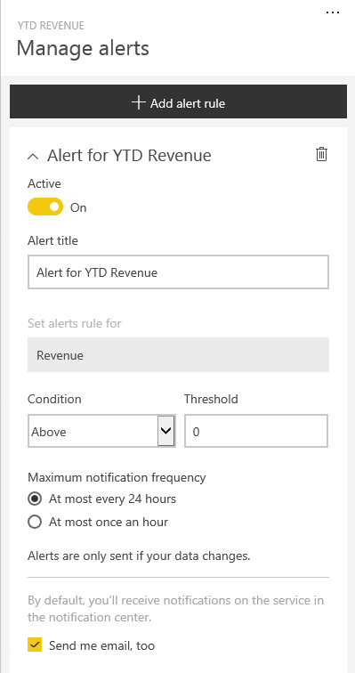
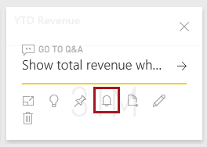
Describing additional capabilities
Data alerts: Creating or managing

Slide 58
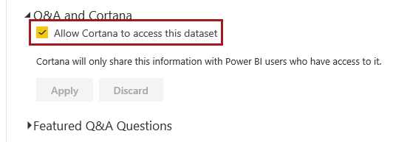
Describing additional capabilities
Cortana for Power BI
Cortana (the personal digital assistant) can look for answers in Power BI datasets by asking questions, similar to Q&A
Requires:
The dataset supports Q&A, and is enabled for Cortana to access
The user has Windows 10 version 1511, or later (November 2015 update)
The user adds their Power BI account to Windows 10
Note: Cortana for Power BI is currently only available in English

Slide 59
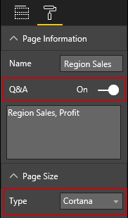
Describing additional capabilities
Cortana for Power BI: Answer pages
Reports can be specifically designed to answer Cortana questions:
Enable Q&A
Set the page size to Cortana
If the report page has page level filters, set Require Single Selection, so Cortana will display the report as an answer if one, and only one, filter item is specified
Ensure that the dataset can be accessed by Cortana
Notes:
https://powerbi.microsoft.com/en-us/documentation/powerbi-service-cortana-desktop-entity-cards/

Slide 60
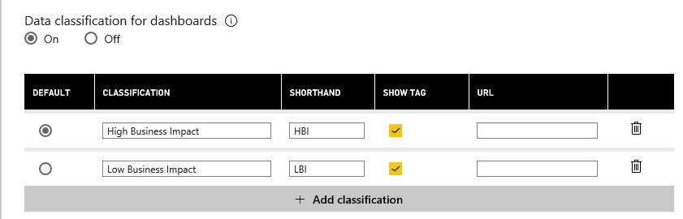
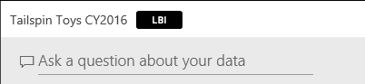
Describing additional capabilities
Dashboard data classification
Dashboards can be classified to raise awareness of what level of security should be used
Classifications can be defined in terms of: Name, shorthand value, whether to display tag and URL
The feature must be enabled by the tenant admin

Slide 61
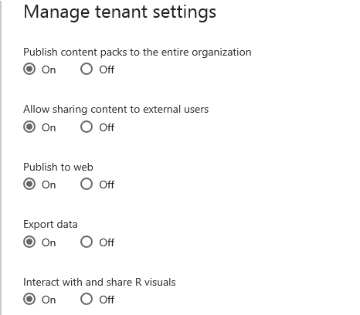
Tenant Settings
Tenant settings can be managed by administrators:

Slide 62
Tenant Settings
All settings
Publish content packs to the entire organization (default On)
Allow sharing content to external users (On)
Publish to web (On)
Export data (On)
Interact with and Share R visuals (On)
Allow users to ask questions about their data using Cortana (On)
Allow users to use Analyze in Excel with on-premises datasets (On)
Allow users to create template organizational content packs (Off)
Create audit logs for internal activity auditing and compliance purposes (Off)
Data classification for dashboards (Off)

Slide 63
Key takeaways
The Power BI online service offers a simple, intuitive experience for interacting with data
Users engage with the service by using a supported web browser, or mobile application
Dashboards display tiles in a single canvas
A tile is sourced by “pinning” either a single report visualization, or a Q&A response
Sharing and collaboration can be achieved by three different, and complimentary, techniques:
Sharing dashboards and tiles
Office 365 groups
Organizational content packs
Entire reports can be easily published to blogs and website
Notes:
Use this slide to describe the key takeaways of the module.

Slide 64
Resources
Power BI Dashboards knowledge base
https://support.powerbi.com/knowledgebase/articles/424868-dashboards-in-power-bi
Q&A in Power BI knowledge base
https://support.powerbi.com/knowledgebase/articles/474566-q-a-in-power-bi
Power BI mobile
https://powerbi.microsoft.com/mobile
Notes:
Use this slide to provide relevant resources to allow attendees to continue with deeper content.

Slide 65
03: Connecting to Power BI data sources
Connecting to Power BI data sources
Keeping data current in Power BI
Integration with Azure services
Notes:
Introduce the module title and topics.
It is recommended that you become fully familiar with the module content by researching the topics at the Power BI knowledgebase: https://support.powerbi.com/knowledgebase - many links are provided in the presenter notes.

Slide 66

Connecting to Power BI data sources
Connecting to data through Power BI is easy, and can be achieved with a variety of data source formats:
Content packs:
My Organization
Services
Files, including:
Power BI Desktop files
Excel workbooks
Databases and data services—cloud and on-premises
Note: Organizational content packs were introduced in the previous module
Notes:
Power BI Knowledgebase:
https://support.powerbi.com/knowledgebase/topics/63369-get-data
https://support.powerbi.com/knowledgebase/topics/88767-files-in-power-bi

Slide 67
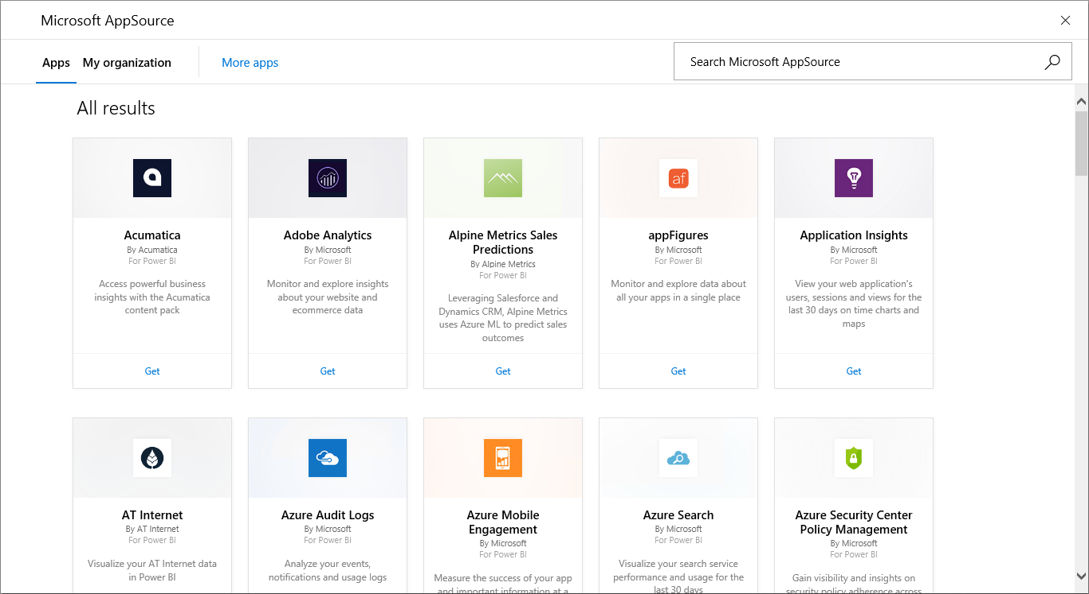
Connecting to Power BI data sources
Formats: Content packs: SaaS applications
Power BI enables connections to SaaS applications
Connections require an existing subscription
Each content pack provides pre-built dashboards and reports

Slide 68
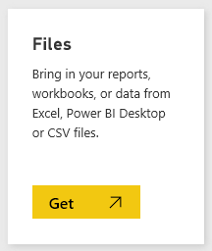
Connecting to Power BI data sources
Formats: Files
Files can be uploaded, or connected to on OneDrive for Business, OneDrive Personal or SharePoint Online
Updates to OneDrive files will appear automatically in dashboards and reports
Supported file types:
Power BI Desktop files
Excel workbooks
CSV files
Maximum size for uploaded files: 250MB
Note: Power BI Desktop files will be covered in the next module

Slide 69
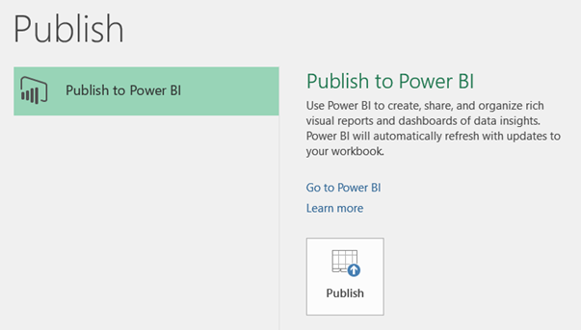
Connecting to Power BI data sources
Formats: Files: Excel 2016
Excel 2016 supports direct publication to the Power BI service
Publication must be made to OneDrive for Business
Updates made from Excel 2016 will be reflected automatically in Power BI datasets

Slide 70
Connecting to Power BI data sources
Formats: Files: Transposition to Power BI
Power BI Desktop files:
File ► Power BI dataset
Report ► Power BI report
An empty dashboard is automatically created, with a token tile to connect to the dataset (drills through to the report)
Excel workbooks:
Data model content takes precedence over worksheet content
Workbook data model ► Power BI dataset
Power View sheets ► Pages of a Power BI report
PivotTables, PivotCharts and custom fields are not recognized

Slide 71
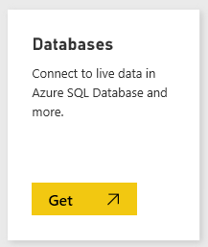
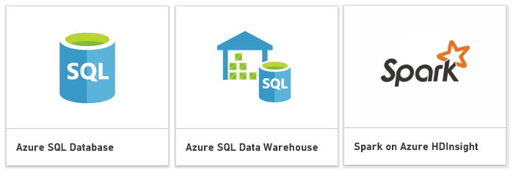
Connecting to Power BI data sources
Formats: Database and data services
Certain Azure (cloud-based) services are available with Direct Connect
Queries are sent back to Azure as users explore and report on data (dashboard tiles refresh every 15 minutes)
These experiences are intended for users who are familiar with the databases and entities they connect to
Only available with the Power BI Pro license
Note: Apache Spark is a fast and general engine for large-scale data processing with Azure HDInsight

Slide 72
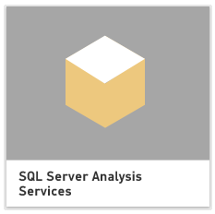
Connecting to Power BI data sources
Formats: Database and data services: SQL Server Analysis Services
Live connections to on-premises data can be made to SQL Server Analysis Services
Supported for SQL Server 2012 and later
The user’s identity is passed through, and so read access is required, and role permissions (row filters) will be enforced
Q&A natural language querying is not supported
Only available with the Power BI Pro license

Slide 73
Connecting to Power BI data sources
Authentication
Power BI connects to data sources as the user
Connections require valid accounts that meet the requirements of the specific data source
Authentication method is specific to connection type
Method | Applies to
Basic | Azure SQL Database | Marketo | OData feeds
Account key | Azure Blob Store | Azure Table Store | Azure HDInsight
OAuth | Salesforce | Google Analytics | OData feeds
Marketplace key | Azure Marketplace
Anonymous | OData feeds | Web

Slide 74
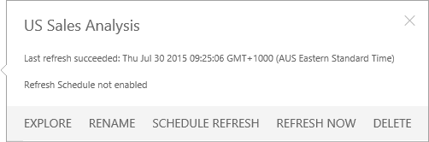
Keeping data current in Power BI
Power BI enables online and on-premises data refresh for datasets uploaded from:
Power BI Desktop files
Excel workbooks, where Power Query or Power Pivot is used to query data
Data refresh can be on-demand, or scheduled
Minimum schedule frequency is hourly
Achieved via a gateway
Personal
On-Premises Data Gateway
Note: Gateway access requires the Power BI Pro license
Notes:
Power BI Knowledgebase: https://support.powerbi.com/knowledgebase/articles/474669-refresh-data-in-power-bi

Slide 75
Keeping data current in Power BI
Authentication
In order for Power BI to refresh a dataset, credentials must be provided for the data sources included in the dataset
Credentials are securely stored so Power BI can connect to the data source on behalf of the user
Once specified, the credentials are retained, and may be updated

Slide 76
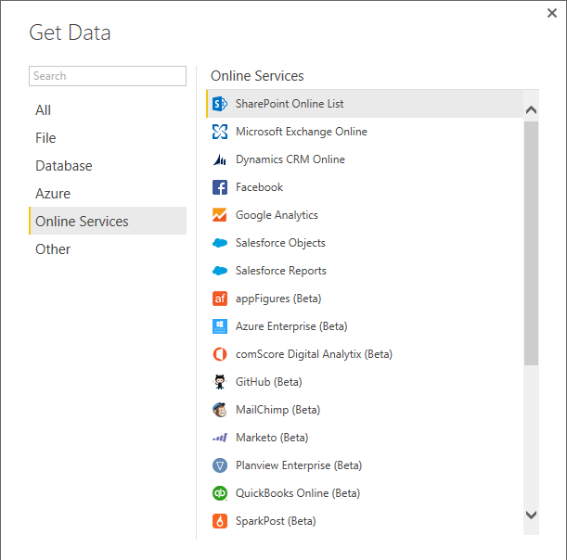
Keeping data current in Power BI
Supported online data sources for refresh
All Azure and Online Services data sources are supported for refresh directly by the Power BI service
For datasets created directly from services, and from Power BI Desktop queries

Slide 77
Keeping data current in Power BI
Supported on-premises data sources for refresh
Note: A gateway is required to refresh on-premises data sources
All other data sources available in Power BI Desktop are supported, except:
Hadoop File (HDFS)
Microsoft Exchange

Slide 78
Keeping data current in Power BI
Power BI Gateway—Personal
Users can install the Power BI Gateway—Personal to refresh supported on-premises data sources
Only available in 64-bit
Runs as a service if configured with an administrator account; otherwise runs as an application
Data transfer is secured (SSL) through Azure Service Bus
There is no requirement to open any firewall ports
Certain scenarios cannot be scheduled for data refresh:
Custom SQL statements
Excel worksheet data
Direct Connect or DirectQuery data sources
Notes:
Power BI Knowledgebase: https://support.powerbi.com/knowledgebase/articles/474669-data-refresh-in-power-bi

Slide 79
Keeping data current in Power BI
On-Premises Data Gateway
IT can install the On-Premises Data Gateway to serve large groups of users to refresh supported on-premises data sources
It is the successor to the Power BI Gateway—Enterprise
IT can:
Centrally manage the set of users who have access to the underlying data sources
Gain visibility into gateway usage, such as most commonly accessed data sources, and the users accessing them
Data sources:
SQL Server Analysis Services (Multidimensional and Tabular modes)
SQL Server
Oracle, Teradata, SAP HANA
Note: For Analysis Services, the Power BI user is passed to Analysis Services as the effective username
Notes:
Power BI Knowledgebase: https://powerbi.microsoft.com/en-us/documentation/powerbi-gateway-enterprise/

Slide 80







Integration with Azure services
Azure and Power BI have the built-in connectivity and integration to bring business intelligence efforts to life
Integration can be achieved without the need to develop complex solutions:
Direct connect:
Azure SQL Database
Azure SQL Data Warehouse
Spark on Azure HDInsight
Power BI Desktop
Real-time dashboards with Azure Stream Analytics
Stream Analytics
Event Hubs
Machine Learning
Power BI
Storage
Note: Direct Connect Azure services were covered earlier in this module
SQL Server
HDInsight
Notes:
Power BI Knowledgebase: https://support.powerbi.com/knowledgebase/articles/568614-azure-and-power-bi

Slide 81
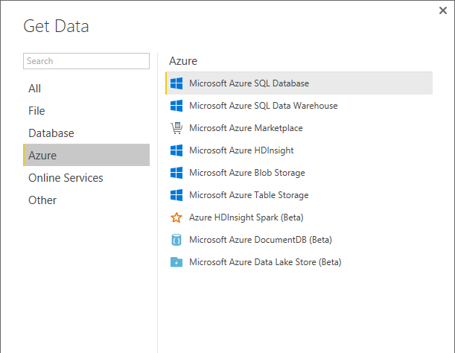
Integration with Azure services
Power BI Desktop
Connect to various Azure services, and create queries
Queries can be integrated with other data source types, not necessarily Azure
Datasets sourced from a Power BI Desktop file can be refreshed
Note: Power BI Desktop is covered in detail in the next module

Slide 82


Integration with Azure services
Real-time dashboards with Azure Stream Analytics
Use Azure Stream Analytics to push live, streaming data to Power BI
Enables real-time dashboards at scale, over data from devices and applications
Can stream millions of events per second
Can perform aggregation over time windows
Tip: Use Q&A to ask: “Show Web Requests where Timestamp is last minute”

Slide 83

Integration with Azure services
Advanced analytics
Coalesce Azure services together to drive advanced analytics:
Azure HDInsight: Big Data processing
Azure Machine Learning: Predictive analytics
Azure Data Factory: Orchestration at scale

Slide 84
Key takeaways
Connecting to data through Power BI is easy
Power BI enables connections to SaaS applications
Files can be uploaded, or connected on OneDrive for Business, OneDrive Personal, or SharePoint Online
Live connections to on-premises data can be made to:
SQL Server Analysis Services (Multidimensional and Tabular modes)
SQL Server
Oracle, Teradata, and SAP HANA
Power BI enables online and on-premises data refresh
Azure and Power BI have the built-in connectivity and integration to easily bring Business Intelligence efforts to life
Notes:
Use this slide to describe the key takeaways of the module.

Slide 85
Resources
Power BI Get Data knowledge base
https://support.powerbi.com/knowledgebase/topics/63369-get-data
Azure and Power BI knowledge base
https://support.powerbi.com/knowledgebase/articles/568614-azure-and-power-bi
Power BI Security whitepaper
https://support.powerbi.com/knowledgebase/articles/667840-power-bi-security
Addresses commonly asked Power BI security questions
Notes:
Use this slide to provide relevant resources to allow attendees to continue with deeper content.

Slide 86
04: Creating Power BI Desktop solutions
Introducing Power BI Desktop
Creating queries
Configuring relationships
Enhancing the model
Securing the model
Designing reports
Publishing to Power BI
Describing additional capabilities
Notes:
Introduce the module title and topics.
It is recommended that you become fully familiar with the module content by researching the topics at the Power BI knowledgebase: https://support.powerbi.com/knowledgebase - many links are provided in the presenter notes.

Slide 87

Introducing Power BI Desktop
Power BI Desktop is a visual data exploration and reporting tool
A freely downloadable 32- or 64-bit desktop application optimized for use with the Power BI service
Integrates proven Microsoft technologies
Excel add-ins: Power Query, Power Pivot and Power View
Enables multiple ways to transform schema and data
Updated (at least) on a monthly basis
Notes:
Power BI Knowledgebase: https://support.powerbi.com/knowledgebase/topics/68530-power-bi-desktop

Slide 88


Introducing Power BI Desktop
Providing feedback
Feedback can be provided:
Send a Smile to convey satisfaction with the tool, or a specific feature
Send a Frown to convey the opposite
Both options open a mail message, with the opposition to include a screenshot and/or formulas
Specific feedback can be sent directly by rating the experience

Slide 89

Introducing Power BI Desktop
User experience: Getting data
A query is defined by “getting data”
Source types include File, Database, Azure, Online Services and Other
Data can be simply and quickly loaded “as is”
Typically: Select type ► Define connection ► Authenticate ► Load
Optionally, the Query Editor can be used to transform queries
Notes:
It all begins by connecting to, and retrieving, data.
Power BI knowledgebase: https://support.powerbi.com/knowledgebase/articles/471635-connect-to-data-in-power-bi-designer

Slide 90

Introducing Power BI Desktop
User experience: Three views
Report view
Data view
Relationships view
Notes:
The three views provide alternate user experiences to work with their model.

Slide 91

Introducing Power BI Desktop
User experience: Report view
Work in Report View to create any number of report pages with visualizations
It provides almost the same design experience as the report Editing View in the Power BI service
A report will have at least one blank page to start, and any number of pages can be added
Pages appear, and can be managed, in the navigator pane
Notes:
Power BI knowledge base: https://support.powerbi.com/knowledgebase/articles/461283-report-view-in-power-bi-designer

Slide 92
Introducing Power BI Desktop
User experience: Report view: Continued
The intent of the application is to land the user on the report canvas as quickly as possible
Built-in intelligence will often infer relationships, and detect data types and categories
Evidence suggests that most schemas are relatively simple, and so the optimized path is: Load data ► Visualize
Many model transformations can be applied while working in Report View
Change data types, formats, calculation formulas
Rename fields
Sort columns
Manage relationships
Note: The versatility of Report View, and the immediate visualization of model transformations, is a strong competitive advantage over many other data analysis and reporting products
Notes:
Stress the messaging on this slide, in particular the note about competitor advantage.

Slide 93

Introducing Power BI Desktop
User experience: Data view
Work in Data View to inspect, explore, and understand data in the model
It is a different experience from how you can view tables, columns, and data in Query Editor
This is a view of the data after it has been loaded into the model
Notes:
Power BI knowledgebase: https://support.powerbi.com/knowledgebase/articles/663202-data-view-in-power-bi-desktop

Slide 94

Introducing Power BI Desktop
User experience: Relationships view
Work in Relationships View to view all tables, columns, measures and relationships in the model
Notes:
Power BI knowledgebase: https://support.powerbi.com/knowledgebase/articles/663229-relationship-view-in-power-bi-desktop

Slide 95
Introducing Power BI Desktop
Complex schemas: Development methodology
In contrast to the simple and quick “get then visualize” approach, more complex schemas may follow this methodology:
Create queries and use the Query Editor to filter, cleanse and reshape data
Configure/refine relationships to establish the foundations of a model
Enrich the model with calculation logic and formatting
Design interactive reports with a broad range of modern data visualizations
Publish solutions directly to the Power BI service
Create queries
Configure relationships
Enhance the model
Design reports
Publish to Power BI

Slide 96
Creating queries
Create queries
Configure relationships
Enhance the model
Design reports
Publish to Power BI
Queries can be edited before loading into the model
Once created, each query:
Is referenced by a unique name
Defines query steps by using the language “M”
Most query step logic does not require writing formulas
Advanced logic can be written, and even exposed as functions
Is used to load data into a model table
Notes:
https://powerbi.microsoft.com/en-us/documentation/powerbi-desktop-data-sources/

Slide 97

Creating queries
Source types: File

Slide 98

Creating queries
Source types: Database

Slide 99

Creating queries
Source types: Azure

Slide 100

Creating queries
Source types: Online Services
The list also includes:
Smartsheet
SQL Sentry (Beta)
Stripe (Beta)
SweetIQ (Beta)
Troux (Beta)
Twilio (Beta)
tyGraph (Beta)
WebTrends (Beta)
Zendesk (Beta)
* As at August, 2016
And the list is growing!

Slide 101

Creating queries
Source types: Other
Note: The following are not supported for on-premises refresh
Hadoop File (HDFS)
Microsoft Exchange

Slide 102

Creating queries
DirectQuery mode
Connections made to supported data sources can connect directly by using DirectQuery:
SQL Server
Azure SQL Database
Azure SQL Data Warehouse
SAP HANA
Oracle Database
Teradata Database
Amazon Redshift (Preview)
Notes:
https://powerbi.microsoft.com/en-us/documentation/powerbi-desktop-use-directquery/

Slide 103
Creating queries
DirectQuery mode: Continued
When published to the Power BI Service:
Until credentials are supplied, opening a published report or exploring a dataset created with a DirectQuery connection to an online service results in an error
For on-premises data sources that use DirectQuery, an On-Premises Data Gateway must be installed and the data sources must be registered to establish a data connection
Benefits:
Allows building visualizations over very large datasets
Reports always use current data

Slide 104
Creating queries
DirectyQuery mode: Continued
Limitations:
All tables must come from a single database
The Query Editor query cannot be overly complex
DAX formula are restricted to a subset of the DAX functions
Relationship filtering is limited to a single direction, rather than both directions
If enabled, a preview feature allows cross filtering in both directions
The data type of a column cannot be changed
Q&A is not supported
Quick Insights are not available

Slide 105

Creating queries
Defining query steps
The Query Editor can be used to filter, cleanse and reshape data into the desired result
Steps can easily be produced by applying column filters, and by using the commands available from the ribbon, or the query and column context menus
It is possible to select a step and preview the data at that step
Steps can be removed – but take care not to remove a step that downstream steps depend on
Step formulas can be viewed or edited in the formula bar

Slide 106
Creating queries
Defining query steps: Commands
Numerous commands are available on the Query Editor ribbons and context menus to:
Manage columns
Reduce rows, including removing errors
Transform
Split
Add columns, by using formulas
As the editor experience is WYSIWYG, users can easily experiment and rollback changes

Slide 107


Creating queries
Defining query steps: Combining queries
New queries can be created by:
Merging two queries (joining on a common column)
Appending two queries (union)
Merge join options include:

Slide 108
Configuring relationships
Create queries
Configure relationships
Enhance the model
Design reports
Publish to Power BI
Relationships enable filters on one table to appropriately propagate filter to other tables
Note: Relationships are not foreign key (integrity) constraints
They can be defined between any two tables, regardless of their data connection or source type
However, they must be based on single columns with matching data types
There is no support for self-referencing relationships

Slide 109
Configuring relationships
Advanced options
It is possible to define multiple relationship paths between two tables
One relationship must be active, and will be used by default during model browsing
The remaining relationships are inactive, and can be used explicitly in model calculations

Slide 110

Configuring relationships
Advanced options: Continued
Configure relationship advanced options to set:
Cardinality
Cross filter direction
The Both option enables many-to-many analysis
Active/inactive
Tip: All options can be interpreted from symbols used in the relationship diagram

Slide 111
Enhancing the model
Create queries
Configure relationships
Enhance the model
Design reports
Publish to Power BI
Model tables can be extended with hierarchies, calculations, and may be hidden (i.e. not available for reporting)
Model column properties can be set:
Data type
Format
Categorization
Spatial types, or web URLs
Sort order, based on another column from the same table
Default summarization (numeric, text and date columns)
Visibility

Slide 112


Enhancing the model
Hierarchies
Hierarchies can be added to a table, enabling navigation between columns (in the one-to-many direction)

Slide 113
Enhancing the model
Calculations
There are three different types of calculations, and each are defined by using DAX:
Calculated columns
Calculated tables
Measures
DAX = Data Analysis EXpressions (DAX), consisting of:
Excel functions (~80 functions)
Table functions
Aggregate functions
Relationship navigation functions
Context modification functions
Time Intelligence functions
Note: DAX theory is not covered in this training course

Slide 114
Enhancing the model
Calculations: Calculated columns
Define Calculated Columns to add new columns to tables
Column values for each row are materialized and stored in the model
If possible, to reduce the model size, avoid creating them
Column values are recalculated when:
The table is refreshed
Formula dependencies are refreshed

Slide 115
Enhancing the model
Calculations: Calculated tables
Define Calculated Tables to add new tables to the model, based on existing data from other tables
Calculated tables are generally best for intermediate calculations of data stored in the model, rather than calculated on the fly
Calculated tables appear in Relationship View, and relationships can be defined with other tables
If possible, to reduce the model size, avoid creating them
Calculated tables are recalculated in the same circumstances as calculated columns
Note: This is an advanced design concept
Notes:
Power BI knowledgebase: https://support.powerbi.com/knowledgebase/articles/741510-calculated-tables-in-power-bi-desktop

Slide 116
Enhancing the model
Calculations: Measures
Define Measures to add aggregation logic to the model
Values are not materialized in the model
Formulas are evaluated at query time
Common aggregate functions:
SUM
COUNT, DISTINCTCOUNT
AVERAGE
MIN, MAX
Note: Summarizable columns are aggregated by reports—so defining measures is not necessary for simple aggregation requirements

Slide 117

Enhancing the model
Tuning the model
The model design can be tuned to improve its usefulness and Q&A response accuracy
Set appropriate column data types, formats and categorization
Ensure relationships are configured
Ensure table and columns are visible/hidden
Ensure table, column and measure names are unique and concise
Define synonyms (in Relationships view) for tables, columns, and calculations

Slide 118
Securing the model
It is possible to restrict data access to datasets for given users
Filters restrict data at the row level, and are assigned to roles
Users are also assigned to roles
Roles are defined in Power BI Desktop
DAX expressions are used to filter tables, and can use the USERNAME() function to retrieve the current user name
Within Power BI Desktop, USERNAME() will return a user in the format of DOMAIN\User
Within the Power BI service, USERNAME() will return the user's User Principal Name (UPN)—looks similar to an email address
Users are assigned in the Power BI service
Notes:
https://powerbi.microsoft.com/en-us/documentation/powerbi-admin-rls/

Slide 119
Securing the model
Row-level security: Continued
Limitations:
Only imported data and DirectQuery connections are supported
Q&A and Cortana are not supported
Analyze in Excel is not supported
External sharing is not supported
Row-level security is a Power BI Pro feature

Slide 120

Designing reports
Create queries
Configure relationships
Enhance the model
Design reports
Publish to Power BI
Reports can be designed based on the visible model interface
The design experience is almost the same as is available in the Power BI online service
Text boxes, images and shapes can be added
Text boxes can contain hyperlinks

Slide 121

Designing reports
Custom visuals
Custom visuals can be imported to extend beyond the out-of-the-box visualizations
A gallery of visuals created by the Power BI community is available at https://app.powerbi.com/visuals
Browse through the visuals or submit one of your own for others to use
The list of available visuals is growing each month
Custom visuals will render in the Power BI service
Note: The topic of custom visual development is covered later in this training course

Slide 122

Designing reports
Custom visuals: Gallery (subset)
* And the list is growing!
Notes:
https://app.powerbi.com/visuals

Slide 123

Publishing to Power BI
Create queries
Configure relationships
Enhance the model
Design reports
Publish to Power BI
The Power BI Desktop file can be uploaded to the Power BI service, or published directly
Publish directly to your workspace or a group
Note, if overwriting an existing dataset:
If there are two or more datasets with the same name, remove one, or rename the Power BI Desktop file
Renaming columns or measures can break existing reports or dashboard tiles

Slide 124
Publishing to Power BI
Continued
If row-level security roles have been defined, once published, assign users to roles

Slide 125
Describing additional capabilities
Query parameters
Power BI template files
Running R scripts
Generating R visuals
Shape maps (Preview)

Slide 126
Describing additional capabilities
Query parameters
Query parameters allow users to easily make parts of their reports and data models depend on one or more parameter values
Parameters are defined in terms of:
Name, Description, Type, Allowed Values, Default and Current Value
Parameters are like other queries, and can be referenced from queries and loaded to the data model
Notes:
https://powerbi.microsoft.com/en-us/blog/deep-dive-into-query-parameters-and-power-bi-templates/

Slide 127

Describing additional capabilities
Query parameters: Continued
Many UX dialogs support referencing parameters, including:
Data source dialogs
Filter Rows dialog
Replace Values dialog

Slide 128
Describing additional capabilities
Power BI template files
Templates allow users to export the definition of a Power BI Desktop report without including the actual data
Power BI Desktop file =
query definitions + data model + report + parameters (if any)
Users can easily instantiate a template by using Power BI Desktop, which will ask them for parameter values (if required) and create a new Power BI Desktop report (PBIX file) based upon the contents in the template file (PBIT file)
Notes:
https://powerbi.microsoft.com/en-us/blog/deep-dive-into-query-parameters-and-power-bi-templates/

Slide 129

Describing additional capabilities
Running R scripts
R scripts can be ran directly in Power BI Desktop, and resulting datasets imported into a Power BI Desktop data model
R must be installed on the local machine
Only data frames are imported
Columns typed as Complex and Vector are not imported
Can be refreshed with a gateway
Notes:
https://powerbi.microsoft.com/en-us/documentation/powerbi-desktop-r-scripts/

Slide 130

Describing additional capabilities
Generating R visuals
R visuals render from R script, accepting input fields
Benefits:
Leverage the voluminous and growing number of out-of-the-box plots available in R
Easily customize R visuals by developing the script
Combine advanced analytics in visuals
Interact with R visuals in Power BI Desktop (filter, and cross-filter are supported)
Notes:
https://powerbi.microsoft.com/en-us/documentation/powerbi-desktop-r-visuals/

Slide 131
Describing additional capabilities
Shape maps (Preview)
A Shape Map visual shows relative comparisons of regions on a map by applying different colors to different regions
In contrast to the Map visual, Shape Map cannot show precise geographical locations of data points on a map
Instead, its main purpose is to show relative comparisons of regions on a map by coloring them differently
Notes:
https://powerbi.microsoft.com/en-us/documentation/powerbi-desktop-shape-map/

Slide 132

Describing additional capabilities
Shape maps (Preview): Continued
Custom maps can be used provided they are in the TopoJSON format
Possibilities:
Geographical maps
Theater seat bookings
Supermarket store layouts

Slide 133
Key takeaways
Power BI Desktop is a companion desktop application to Power BI
Power BI Desktop is a visual data exploration and reporting tool
The tool enables simple and quick visualization of data
For complex schemas, a development methodology can involve:
Creating queries
Configuring relationships
Enhancing the model with hierarchies and calculations
Designing reports, including the use of custom visuals
Publishing to Power BI
The user can choose to work in the way that makes sense to them
Power BI Desktop files, once published, can have their data sources refreshed
Notes:
Use this slide to describe the key takeaways of the module.

Slide 134
Resources
Power BI Desktop knowledge base
https://support.powerbi.com/knowledgebase/topics/68530-power-bi-desktop
Tips and tricks for creating reports in Power BI Desktop
https://support.powerbi.com/knowledgebase/articles/464157-tips-and-tricks-for-creating-reports-in-power-bi-d
DAX Resource Center
“Your one stop shop for all things DAX”
http://social.technet.microsoft.com/wiki/contents/articles/1088.dax-resource-center.aspx
Notes:
Use this slide to provide relevant resources to allow attendees to continue with deeper content.

Slide 135
Resources
Power BI Visuals Gallery
https://app.powerbi.com/visuals
Notes:
Use this slide to provide relevant resources to allow attendees to continue with deeper content.

Slide 136
05: Power BI for the developer
Extending Power BI
Power BI REST API
Custom visuals
Azure Power BI Embedded
Notes:
Introduce the module title and topics.
It is recommended that you become fully familiar with the module content by researching the topics at the Power BI knowledgebase: https://support.powerbi.com/knowledgebase - many links are provided in the presenter notes.

Slide 137
Extending Power BI
Exciting opportunities exist for developers to extend, embed and customize the Power BI experience
Power BI REST API
Integrate Power BI into an app (in preview)
Custom visuals
Azure Power BI Embedded

Slide 138
Power BI REST API
Use the Power BI REST API to push data directly from an application into a Power BI dataset
Client application
Web application
Programmatically manage resources:
Datasets
Tables
Dashboards will update in real-time as data is added
No more waiting, or needing to press the Refresh button! ☺
Notes:
Power BI Knowledgebase: https://powerbi.microsoft.com/developers

Slide 139

Power BI REST API
Object model hierarchy
A Power BI workspace can have multiple datasets, which are identified by a GUID
A dataset can:
Be owned by a user or a group
Have multiple tables, which are referenced by name
A table has multiple rows
Power BI
Datasets
Tables
Rows

Slide 140

Power BI REST API
Authentication
An application must be registered, and is required to establish an identity for the application
Applications are identified by their Client ID
Permissions are delegated to the Power BI service
REST API calls are made on behalf of an authenticated user by passing a token in the “Authorization” header

Slide 141
Power BI REST API
Application registration
An application can be registered with
Power BI App Registration Tool at http://dev.powerbi.com/apps, or
Azure Management Portal
The Power BI App Registration Tool is the easiest option since there are just a few fields to fill in
If you want to make changes to you app, this can only be done through the Azure Management Portal

Slide 142

Power BI REST API
Authentication flow: Client application

Slide 143

Power BI REST API
Authentication flow: Web application

Slide 144
Power BI REST API
Operations
Operation | Method
List all datasets | GET | Returns a JSON list of all dataset objects that includes a name and dataset ID
Create a dataset | POST | Creates a new dataset with the schema definition that is in the JSON body, and returns the dataset ID and the properties of the objects created
List all tables | GET | Returns a JSON list of tables for the specified dataset
Update an existing table schema | PUT
Add rows to a table in a dataset | POST
Clear the rows in a table | DELETE
List all groups | GET | Returns a JSON list of all the groups of which the user is a member
List all dashboards | GET | (In preview)
List all dashboard tiles | GET | (In preview) Returns a JSON list of tiles for the specified dashboard. Use this method to retrieve the embed URL.
List all reports | GET | (In preview) Use this method to retrieve the embed URL
Notes:
Useful link: http://docs.powerbi.apiary.io/#

Slide 145
Power BI REST API
Example: List all datasets
Request
GET https://api.powerbi.com/v1.0/myorg/datasets HTTP/1.1 Authorization: Bearer {AAD Token} Content-Type: application/json; charset=utf-8
Response
{ "datasets": [ { "id": "2C0CCF12-A369-4985-A643-0995C249D5B9", "name": "Music" }, { "id": "C446840B-94AD-4B23-8896-C276E69B8FAA", "name": "SalesMarketing" } ] }

Slide 146
Power BI REST API
Example: Add a row to a table in a dataset
Request
POST https://api.powerbi.com/v1.0/myorg/datasets/2C0CCF12-A369-4985-A643-0995C249D5B9 /Tables/Product/Rows HTTP/1.1 Authorization: Bearer {AAD Token} Content-Type: application/json; charset=utf-8 { "rows": [ { "ProductID":1, "Name":"Adjustable Race", "Category":"Components", "IsCompete":true, "ManufacturedOn":"07/30/2014" } ] }

Slide 147
Power BI REST API
Restrictions
Maximum rows per single push: 10K
Note that ingestion rates are restricted by license:
Power BI license: 10K rows/hour
Power BI Pro license : 1M rows/hour
Maximum rows per table: 5M
A dataset is defined with a retention policy:
none: Rows will be collected to the limit
basicFIFO: Will keep up to 200K rows, and remove the oldest rows as new rows are added
Maximum pending requests: 5

Slide 148
Integrate Power BI
Integrate a Power BI tile or report into an app with an IFrame HTML element
For example, create a custom mobile app to display real-time Power BI tiles and reports on the user’s mobile device
Use the REST API to retrieve the embed URL
Once embedded, a click event handler can be added to enable navigation to the dashboard
This capability is presently in preview

Slide 149
Custom visuals
Developers can develop custom visuals for use in Power BI solutions
To help developers get started, Microsoft has published the code for all of their visualizations
This is all available as an open source project on GitHub
The project contains over 20 visualization types, the framework to run them, and the testing infrastructure that enables you to build high quality visualizations
The framework provides all the interfaces required to integrate fully with Power BI's selection, filtering, and other UI experiences
Developers are encouraged to submit their custom visuals to the Power BI Visuals Gallery for sharing with the Power BI community
Notes:
Useful link: https://powerbi.microsoft.com/custom-visuals

Slide 150
Azure Power BI Embedded
Azure Power BI Embedded is an Azure service, enabling the integration of Power BI reports into apps
Notes:
https://azure.microsoft.com/en-us/services/power-bi-embedded/

Slide 151
Azure Power BI Embedded
Create compelling interactive reports
Embed easily for faster time to value
Deploy quickly and manage with ease

Slide 152
Azure Power BI Embedded
Key attributes
Easily author interactive reports without writing any code using Power BI Desktop
Choose modern visualizations out-of-the-box or customize without building them from scratch for your reports
Easily embed interactive visuals in your app using REST APIs and the Power BI SDK
Ensure consistent high-fidelity data experiences on any device
Use your existing authentication and authorization methods
Speed up time to value without redesigning your existing app
Pay only for what you use with no upfront costs

Slide 153



Azure Power BI Embedded
Conceptual model
1,N
Microsoft Azure subscription
Developer
1,N
Workspace collection
Azure SQL Database
Azure SQL Data Warehouse
1,N
on Azure HDInsight
Workspace
Embed
Your app
End users

Slide 154
Azure Power BI Embedded
Pricing
Free: 100 sessions/month
Standard: USD 0.05/session
Session = “A session ends when either the user closes the report, or one hour after the session was initiated, whichever comes first.”
Notes:
https://azure.microsoft.com/en-us/services/power-bi-embedded/

Slide 155
Key takeaways
The Power BI REST API can push data directly from an application into a Power BI dataset
Developers can integrate Power BI tiles and reports into application
Developers can develop custom visuals for use in Power BI solutions
Developers can embed compelling, interactive reports within their web apps
Notes:
Use this slide to describe the key takeaways of the module.

Slide 156
Resources
Power BI Developer Center
https://powerbi.microsoft.com/developers
Power BI App Registration Tool
http://dev.powerbi.com/apps
Power BI REST API Console
http://docs.powerbi.apiary.io
Test each of the REST API operations using the console interface
Notes:
Use this slide to provide relevant resources to allow attendees to continue with deeper content.

Slide 157
Resources
GitHub: Integrate a tile into an app
https://github.com/Microsoft/PowerBI-CSharp/tree/master/samples/webforms/embed-a-tile-into-an-app
GitHub: Integrate a report into an app
https://github.com/Microsoft/PowerBI-CSharp/tree/master/samples/webforms/embed-a-report-into-an-app
Notes:
Use this slide to provide relevant resources to allow attendees to continue with deeper content.

Slide 158
Resources
Extend Power BI with Custom Visuals
https://powerbi.microsoft.com/custom-visuals
https://github.com/microsoft/powerbi-visuals
Power BI Visuals Gallery
https://app.powerbi.com/visuals
Submit custom visuals for discovery and use by the Power BI community
Azure Power BI Embedded
https://azure.microsoft.com/en-us/services/power-bi-embedded
https://azure.microsoft.com/en-us/pricing/details/power-bi-embedded/
Notes:
Use this slide to provide relevant resources to allow attendees to continue with deeper content.

Slide 159
06: Summary
Power BI overview
Power BI benefits by role
Power BI licensing
Signing up for Power BI
Notes:
Introduce the module title and topics.

Slide 160
Power BI overview
SaaS solutions
E.g. Marketo, Salesforce, GitHub, Google analytics
Content packs
Natural language query
Sharing & collaboration
On-premises data
E.g. Analysis Services
Live dashboards
Organizational content packs Corporate data sources or external data services
Visualizations
Azure services
E.g. Azure SQL, Stream Analytics
Excel files
Workbook data and data models
Reports
01001
10101
Power BI Desktop files
Related data from files, databases, Azure, and other sources
Datasets
0110001
00010110
Data refresh
Power BI Desktop
Power BI REST API
Prepare
Explore
Report
Share

Slide 161
Power BI benefits by role
Whatever the role, Power BI brings all data together
Business user
Import data from SaaS sources, and work with dashboards and reports
Business analyst
Import, reshape and model data
Create compelling reports and visualizations
Create content packs to share insights
BI professional
Connect to live Azure data services
Connect to on-premises Analysis Services databases
Empower colleagues to create their own reports
Developer
Integrate applications with Power BI
Create real-time dashboards
Develop custom visuals

Slide 162
Power BI licensing
Two licenses are available, subject to change:
Power BI: Free! ☺
Power BI Pro: Currently USD 9.99/month with an annual subscription (Academic, government and non-profit pricing is available)
Encourage customers to review the pricing and feature matrix
https://powerbi.microsoft.com/pricing
Power BI Pro trial license can be obtained for 60 days
Notes:
Encourage customers to review the pricing and feature matrix:
https://powerbi.microsoft.com/pricing

Slide 163
Power BI licensing
Feature differences
In short, the differences between the two licenses:
Feature | Power BI (Free) | Power BI Pro
Data capacity limit | 1 GB/user | 10 GB/user
Consume content that is scheduled to refresh | Daily | Up to 8 times per day
Data streaming rate | 10K rows/hour | 1M rows/hour
Consume live data sources will full interactivity | No | Yes
Access on-premises data with gateways | No | Yes
Share dashboards | Yes | Yes
All other collaboration features | No | Yes
Row-level security for users and groups | No | Yes
Non-”Power BI Pro” users can share dashboards. However, a Power BI Pro license is required to interact with, or consume, content using features that are only available to users with a Power BI Pro license.
Notes:
This slide conveniently summarizes the differences between the two license tiers.
Power BI knowledgebase: Power BI Pro content: https://support.powerbi.com/knowledgebase/articles/685479-power-bi-pro-content-what-is-it

Slide 164
Resources
Power BI site
http://powerbi.microsoft.com
Power BI documentation
http://support.powerbi.com/
Power BI community
http://community.powerbi.com/
Power BI blog
http://blogs.msdn.com/b/powerbi/
Tip: Power BI is evolving at a rapid rate. One of the best ways to keep pace with updates is to subscribe to the Power BI blog.
Notes:
Use this slide to provide relevant resources to allow attendees to continue with deeper content.

Slide 165
Resources
Continued
Power BI pricing
https://powerbi.microsoft.com/pricing
Microsoft Cloud and Enterprise Partner Resources
http://aka.ms/powerbipartners
Includes up-to-date resources:
Customer-ready materials
Customer evidence
Training and labs
Demos
“What to do next”
Notes:
Use this slide to provide relevant resources to allow attendees to continue with deeper content.

Slide 166

Resources
Continued
https://technet.microsoft.com/en-us/virtuallabs
Search the growing library of Power BI technical labs
Notes:
https://technet.microsoft.com/en-us/virtuallabs

Slide 167

Get started today at powerbi.com
Sign up for a free Preview account
Take the Power BI Tour
Notes:
Use this slide to wrap up the training event, and to encourage attendees to sign up for Power BI by using their organization account.

Slide 168
Notes:
Thank you for attending this presentation! ☺

